Slide 1
Numbers & String

Slide 2
Strings
In programming, textual data is represented by strings – ordered sequences of characters.

Slide 3
substring
Your first task is to write a function that allows a player to place an order with the tavern master.
Within the new placeOrder function, use String’s indexOf and substring functions to extract the tavern master’s name from the TAVERN_NAME string and display it. (We will walk through each line of placeOrder after you add it.) Also, remove the old beverage code from the previous exercise. The tavern will feature more than beverage items, and Buttered Ale is no longer lawful to serve in the realm anyway.
First, you use String’s indexOf function to get the index of the first apostrophe in the String:
val indexOfFirstApostrophe = BAR_NAME.indexOf('\‘’)
An index is an integer that corresponds to the position of a character in the string. The index starts at 0 for the first character. The next character has the index 1, the next 2, and so forth.
What is the \ doing in that argument? The apostrophe character is also the single quotation mark that signals a character literal. If you entered your argument as ''', the compiler would read the apostrophe in the middle as a single quotation mark enclosing an empty character literal. You need to let the compiler know that you are specifying the apostrophe character instead, and you do this with the \ escape character, which distinguishes between certain characters and special meanings they have to the compiler.
substring accepts an IntRange (a type that represents a range of integers) that determines the indices of the characters to extract. In this case, the range starts with the first character and ends with the character before the first apostrophe (recall that until creates a range that excludes the specified upper bound).

Slide 4
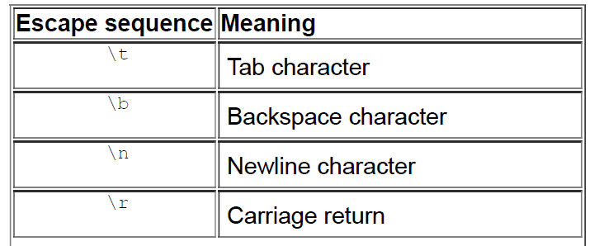
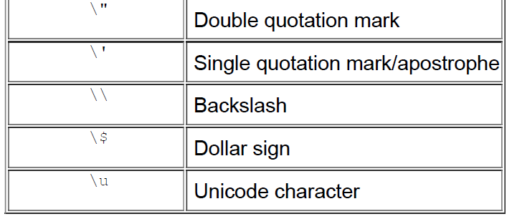

Slide 5
const val BAR_NAME = “Parsa’s Bar"
fun main(args: Array<String>) {
placeOrder()
}
private fun placeOrder() {
val indexOfApostrophe = BAR.indexOf('\'')
val barMaster = BAR_NAME .substring(0 until indexOfApostrophe)
println(“Amir speaks with $tavernMaster about their order.")
}

Slide 6
split
Next, to extract the individual parts of the menu data for display, you are going to use String’s split function, which creates a series of substrings using a delimiter you provide. Add the split function to placeOrder:
split accepts a delimiter character to look for and returns a list of the resulting substrings with the delimiter omitted. In this case, split returns a list of strings in the order it found them. You use indices in square brackets, officially known as the indexedaccess operator, to extract the first, second, and third strings from the list and assign them as the values of the variables type, name, and price.

Slide 7
const val BAR_NAME = “Parsa’s Bar"
fun main(args: Array<String>) {
placeOrder()
}
private fun placeOrder(menuData: String)) {
val indexOfApostrophe = BAR.indexOf('\'')
val barMaster = BAR_NAME .substring(0 until indexOfApostrophe)
println(“Amir speaks with $tavernMaster about their order.")
val data = menuData.split(',')
val type = data[0]
val name = data[1]
val price = data[2]
val message = “Amir buys a $name ($type) for $price."
println(message)
}

Slide 8
String Manipulation
The version of the replace function you used accepts two arguments. The first argument is a regular expression that determines which characters you want to replace. A regular Expression The second argument is an anonymous function that defines what you want to replace each matching character with.
Strings are immutable
In reality, the replace function does not “replace” any part of the phrase variable. Instead, replace creates a new string. It uses the old string’s value as an input and chooses characters for the new string using the expression you provide.
Whether they are defined with var or val, all strings in Kotlin are actually immutable (as they are in Java). Though the variables that hold the value for the String can be reassigned if the string is a var, the string instance itself can never be changed. Any function that appears to change the value of a string (like replace) actually creates a new string with the changes applied to it.

Slide 9
String Comparison
using the structural equality operator, ==. You have seen this operator before, used with numeric values. When used with strings, it checks that the characters in each string match one another and are in the same order.

Slide 10
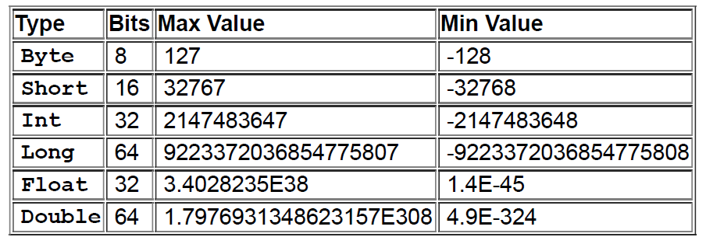
Kotlin has a variety of types for dealing with numbers and numeric computations. Multiple types are available for each of the two main varieties of numbers that Kotlin can work with: whole-number integers and numbers with decimals.

Slide 11
Converting a String to a Numeric Type
The good news is that Kotlin includes functions that convert strings
to different types – including numbers. Some of the most commonly
used of these conversion functions are:
toFloat
toDouble
toDoubleOrNull
toIntOrNull
toLong
toBigDecimal

Slide 12
Attempting to convert a string of the wrong format will throw an exception. For example, calling toInt on a string with the value “5.91” would throw an exception, since the decimal portion of the string value would not fit into an Int.
Because of the possibility of exceptions when converting between different numeric types, Kotlin also provides the safe conversion functions toDoubleOrNull and toIntOrNull. When the number does not convert correctly, a null value is returned instead of an exception. You could use the null coalescing operator with toIntOrNull, for example, to provide a default value:
val gold: Int = "5.91".toIntOrNull() ?: 0

Slide 13
Converting an Int to a Double
If you divide an Int, by 100, also an Int, Kotlin would not give you 0.10, a Double. Instead, you would get another Int – 0, in fact – that loses the decimal result you are looking for
Because both numbers in the operation are integers, Kotlin performs integer arithmetic, which does not support a result with a decimal. To get a decimal result, you need Kotlin to perform floating-point arithmetic, which you achieve by including in the operation at least one type that supports a decimal.
again, but this time add a decimal to either number to indicate that floating-point arithmetic should be used and the result should be a Double (0.1).

Slide 14
Converting a Double to an Int
Note that calling toInt on a double is different than calling toInt on a string like "5.91", which would result in an exception beingthrown. The difference is that converting a string to a double requires parsing the string to turn it into a numeric type, whereas a type that is already numeric, like Double or Int, does not require any parsing.

